Slide 1
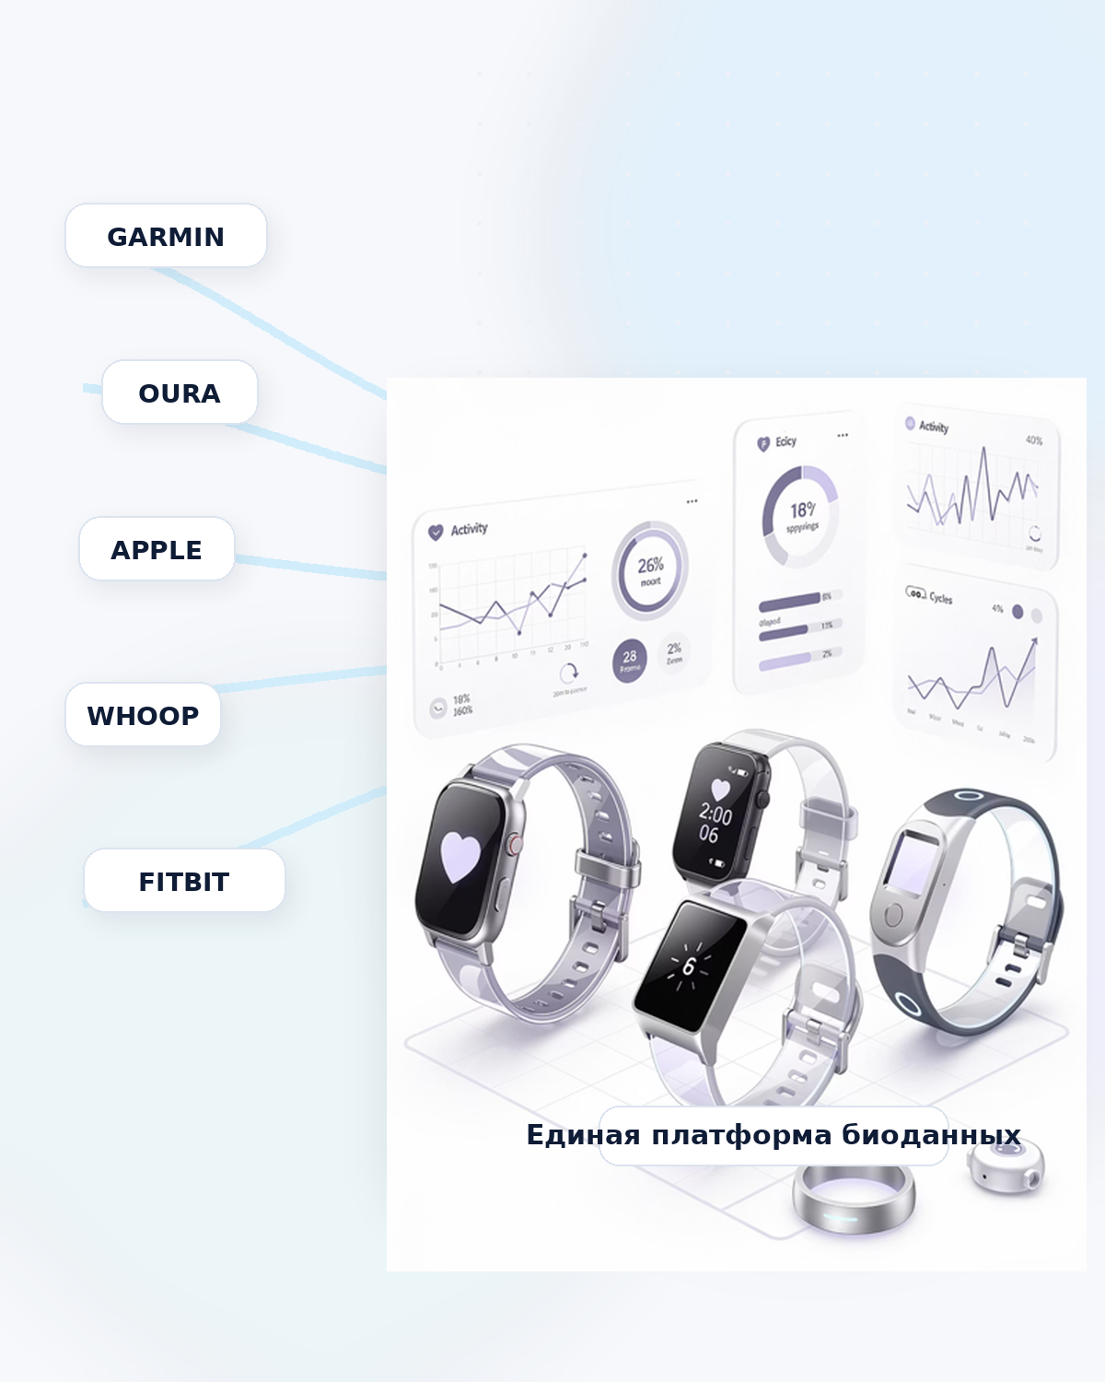
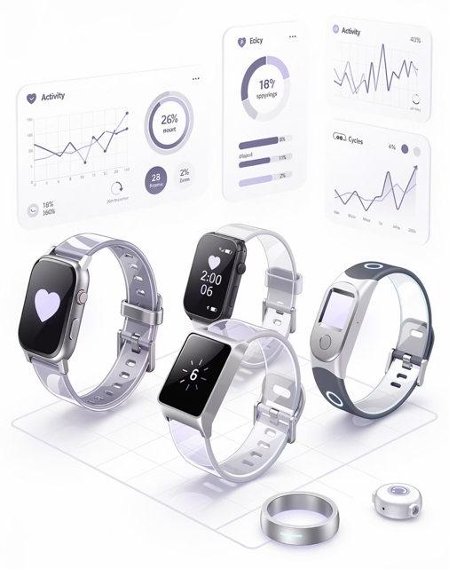

LifeScreen for CROs and sponsors
Brand-agnostic remote monitoring and patient support for clinical trials
LifeScreen turns daily data from wearables and mobile channels into a practical layer for study sites, contract research organizations and sponsors.
50+ devices
20+ metrics
Remote monitoring
Medical Integration
Alerts, diaries, reminders
Data exports & dashboards
Best initial role: mixed and decentralized studies, secondary or exploratory endpoints, safety and adherence layers, and post-authorization projects.
Unified BioData Platform
Clinical trials use case
Notes:
[Sources]
- LifeScreen product materials and internal product screenshots, March–April 2026.
- LifeScreen clinical trials analytical study, 2026.

Slide 2

DRUG CLINICAL TRIALS
The market is ready. The missing layer is between data and action
Wearables, remote visits and digital tools already exist. What many protocols still lack is a usable layer between the device, the patient and the investigator.
FDA + ICH
$10.74B → $21.06B
~30% / 8%
Regulatory basis already exists
Decentralized trials market
Russia is still under-digitized
Remote data acquisition and machine-sourced data are no longer peripheral ideas. They are part of the current clinical trial rulebook.
Estimated market growth from 2026 to 2031 for decentralized clinical trials.
Around 30% of sites report experience with decentralized elements, but only 8% use them regularly.
Where LifeScreen fits
Devices
LifeScreen
Site
Instead of replacing the core trial data system, LifeScreen can be introduced as an additional patient-facing and investigator-facing layer: it helps collect continuous data between visits, supports patient discipline, flags signals for the site, and prepares analysis-friendly exports for the sponsor or contract research organization.
Remote collection
Alerts & adherence
Data exports
A practical digital layer for mixed and decentralized trials
2
Notes:
[Sources]
- FDA. Digital Health Technologies for Remote Data Acquisition in Clinical Investigations, 2023.
- ICH. Guideline for Good Clinical Practice E6(R3), 2025.
- Mordor Intelligence. Decentralized Clinical Trials Market, 2026–2031.
- Skolkovo MedPharm / Pharmvestnik. Russian market readiness for decentralized trials, 2026.
- LifeScreen clinical trials analytical study, 2026.

Slide 3
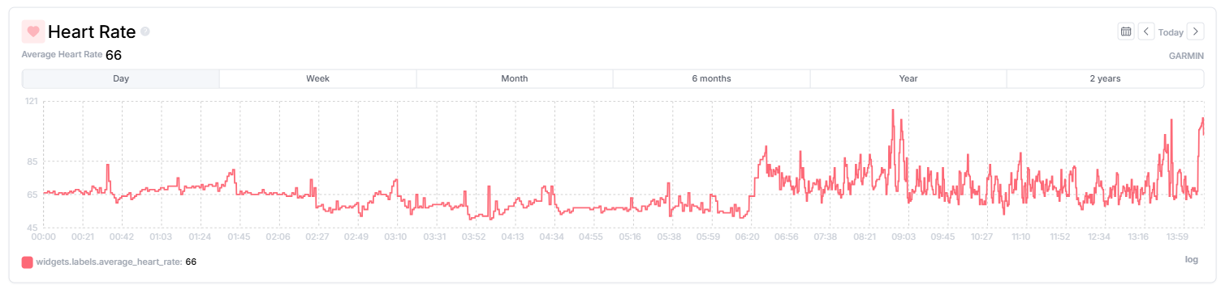
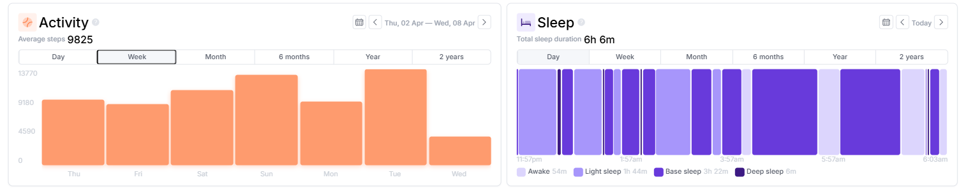
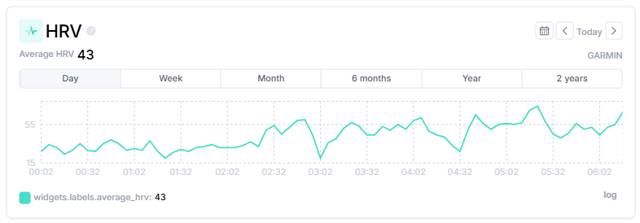
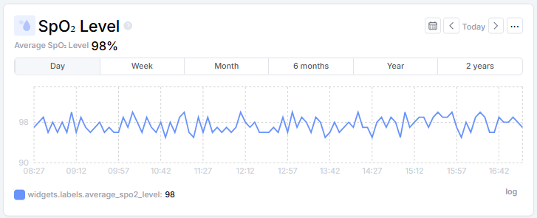
DRUG CLINICAL TRIALS
What the platform already does
LifeScreen is not a wearable and not a standalone app. It is a brand-agnostic layer that connects devices, analytics and specialist actions in one workflow.
50+ integrations
Selected product views (examples)
Devices and services
Garmin, Oura, Apple, Fitbit, Google Fit, Polar, Withings, CGM and more.
20+ metrics
Continuous patient data
Activity, sleep, heart rate, HRV, stress, respiration, SpO₂, glucose and other parameters.
Medical Integration
Fully configurable to any clinical environment
Connect ECG, MRI, lab results, medical devices, and external systems via any protocol
Patient support
Daily trial operations
Diaries, reminders, video communication, plans, compliance support and investigator notes.
Alerts & dashboards
What the site actually sees
Signals, grouped monitoring and analysis-ready exports.
3
Notes:
[Sources]
- LifeScreen product materials and internal product screenshots, March–April 2026.

Slide 4
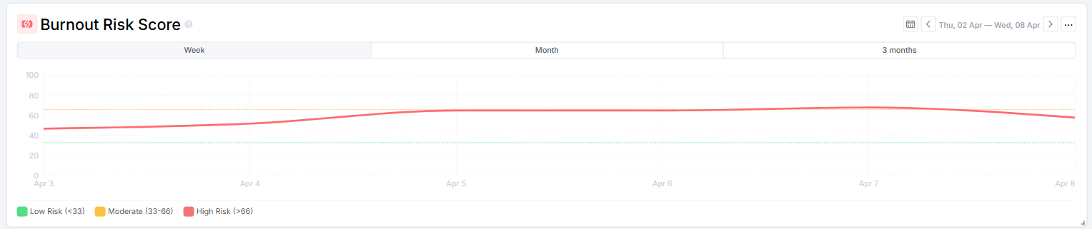
DRUG CLINICAL TRIALS
Where LifeScreen fits in the trial workflow
Recommended starting position: an additional digital layer for mixed and decentralized studies, not a replacement of the primary EDC or trial-management system.
1
Baseline at site
2
Home monitoring
3
Signals for the site
4
Export & review
Best initial roles
Patient baseline profile, device connection and digital onboarding.
Daily metrics, diaries and patient-reported information between visits.
Safety, tolerability and adherence signals for the investigator and study team.
Structured exports and summary dashboards for the CRO, sponsor and site.
• Secondary or exploratory endpoints
• Safety and adherence layer
• Post-dose follow-up
• Post-authorization and pragmatic studies
Continuous signals matter when the protocol needs day-to-day visibility between visits.
4
Notes:
[Sources]
- LifeScreen product materials and internal product screenshots, March–April 2026.
- FDA. Digital Health Technologies for Remote Data Acquisition in Clinical Investigations, 2023.
- ICH. Guideline for Good Clinical Practice E6(R3), 2025.

Slide 5
DRUG CLINICAL TRIALS
International benchmarks suggest meaningful time and cost impact
For LifeScreen, the most relevant comparison set is mixed and decentralized studies using wearables, digital diaries and digital endpoints.
74–85%
−60%
−15% / −32%
3.3–5.2 months
Remote-capable procedures
Fewer visits in DAPA-MI
CRESCENDO
Tufts / digital endpoints
In selected AstraZeneca protocols, this share of procedures could be collected remotely; onsite visits could be reduced by up to 40%.
Digital study model with a reported 43% lower cost per patient versus a more traditional comparator.
Study duration reduced by 15% and cost by 32%; fewer missing data and stronger statistical power.
Phase II and III time reduction range reported in the Tufts/DiMe analysis.
First-pilot benchmark
A conservative management benchmark for early pilots in Russia and the EAEU is a 1–3 month timeline reduction, a 5–12% decrease in direct operating budget, and a 5–15 percentage-point reduction in dropout or loss of analyzable data. These are benchmark ranges based on international practice, not guaranteed outcomes.
Why the effect appears
Shorter timelines come from four sources: fewer onsite visits, faster signal detection, better patient retention, and less manual reconciliation of continuous data.
Benchmark values; protocol-specific validation is still required.
5
Notes:
[Sources]
- Durán C.O. et al. Implementation of digital health technology in clinical trials: the 6R framework. Nature Medicine, 2023.
- DiMasi J.A. et al. Assessing the Financial Value of Decentralized Clinical Trials, 2023.
- DiMasi J.A. et al. Assessing the Net Financial Benefits of Employing Digital Endpoints in Clinical Trials, 2024.
- LifeScreen estimate for first pilots based on international benchmarks from the analytical study, 2026.

Slide 6
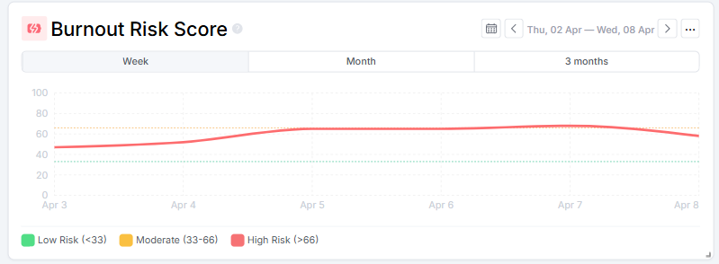
DRUG CLINICAL TRIALS
Best entry use cases for early pilots
The strongest starting point is a protocol with relatively low regulatory risk but high day-to-day value of activity, sleep, heart-rate, symptom and tolerability data.
Cardiometabolic disease
Obesity & diabetes
What to measure first
Activity, sleep, heart-rate and treatment adherence matter every day.
Continuous behavior and glucose-related patterns make the digital layer naturally useful.
Activity
Sleep
HR
HRV
Symptoms
PRO
Respiratory disease
Supportive oncology care
Recommended starting role: one passive domain + one patient-reported domain + one safety/adherence workflow.
Home monitoring helps capture symptom dynamics and treatment tolerability outside the site.
Remote follow-up can help detect side-effect trends and patient deterioration earlier.
Pain & rehabilitation
Post-authorization & pragmatic studies
Recovery, mobility and day-to-day functioning are difficult to understand from sparse site visits alone.
Good place to validate the workflow with lower regulatory friction.
Continuous trends are most useful when the protocol needs everyday visibility rather than isolated site readings.
6
Notes:
[Sources]
- EMA/HMA Big Data Steering Group. mHealth Data for Real-World Evidence in Regulatory Decision Making, 2024.
- Merck. How wearable technology powers patient-focused drug development, 2026.
- LifeScreen clinical trials analytical study, 2026.

Slide 7
DRUG CLINICAL TRIALS
Commercial proposal for CROs and sponsors
Recommended positioning: not a universal trial platform, but a specialized module for remote monitoring, patient support and structured data exports.
Pilot for one protocol
Flexible deployment
Structured outputs
What is delivered
How it is delivered
What the CRO receives
Wearable and mobile patient layer, daily monitoring, diaries, reminders, signals and a site/CRO dashboard.
Secure cloud, private cloud or customer perimeter; Russian-language onboarding and operational support.
Analysis-ready exports, signal tracking, patient support records and a practical investigator-facing view.
Target pilot outcomes
Conservative benchmark for first pilots
1–3 months timeline reduction
5–12% lower direct operating budget
5–15 pp lower dropout / analyzable-data loss
• Better data completeness
• Fewer missed visits and query cycles
• Stronger patient discipline
• Lower site burden for routine follow-up
Benchmark ranges based on international practice and intended for pilot planning, not guaranteed outcomes.
Recommended first step: choose one protocol where daily patient behavior, tolerability or recovery outside the site already matters, then add LifeScreen as a contained module rather than redesigning the whole study.
7
Notes:
[Sources]
- DiMasi J.A. et al. Assessing the Financial Value of Decentralized Clinical Trials, 2023.
- DiMasi J.A. et al. Assessing the Net Financial Benefits of Employing Digital Endpoints in Clinical Trials, 2024.
- Skolkovo MedPharm / Pharmvestnik. Russian market readiness for decentralized trials, 2026.
- LifeScreen clinical trials analytical study, 2026.

